Slide 1
Schema Registry
A repository for storing schema of messages.
A separate schema registry process maintains the schema registry
Each Schema is allocated globally unique id.
Producers can register to Schema.
Consumer can retrieve the Schema.
Supports Avro, Json and Protobuf schemas.
Schemas can be nested.
Schema evolution supported through Avro.
Producer1
Messages
Kafka
Messages
Consumer 1
Schema
Schema
Schema Registry

Slide 2
Schema Registry Evolution supported through Avro
An important aspect of data management is schema evolution. After the initial schema is defined, applications may need to evolve it over time. When this happens, it’s critical for the downstream consumers to be able to handle data encoded with both the old and the new schema seamlessly.
There are three common patterns of schema evolution:
backward compatibility -
forward compatibility -
full compatibility
Backward Compatibility: Backward compatibility means that data encoded with an older schema can be read with a newer schema.
(Data Read : Old schema -> New Schema)
Consider the case where all the data in Kafka is also loaded into HDFS, and we want to run SQL queries (e.g., using Apache Hive) over all the data. Here, it is important that the same SQl queries continue to work even as the data is undergoing changes over time. To support this kind of use case, we can evolve the schemas in a backward compatible way.
Note that the new field favorite_color has the default value “green”. This allows data encoded with the old schema to be read with the new schema. The default value specified in the new schema will be used for the missing field when deserializing the data encoded with the old schema. Had the default value been ommitted in the new field, the new schema would not be backward compatible with the old one since it’s not clear what value should be assigned to the new field, which is missing in the old data.
New Schema adding new field with Default value
{
"namespace":"example.avro",
"type":"record",
"name":"user",
"fields":[
{
"name":"name",
"type":"string"
},
{
"name":"favorite_number",
"type":"int"
},
{
"name":"favorite_color", < - New field
"type":"string",
"default":"green"
}
]
}

Slide 3
Forward Compatibility: Forward compatibility means that data encoded with a newer schema can be read with an older schema.
(Data Read : Old schema <- New Schema)
Consider a use case where a consumer has application logic tied to a particular version of the schema. When the schema evolves, the application logic may not be updated immediately. Therefore, we need to be able to project data with newer schemas onto the (older) schema that the application understands.
New Field Added : New field added in new schema with the default value. From Old Schema, when projecting data written with the new schema to the old one, the new field is simply dropped. (FORWARD Compatible)
Existing Field Dropped : New schema dropped the original field favorite_number. Old schema is not forward compatible with new schema since data created with new schema cannot be accommodated to old schema, as there is no default value in old schema for removed field in new schema.
Full Compatibility : Full compatibility means schemas are backward and forward compatible.
To support both previous use cases on the same data, we can evolve the schemas in a fully compatible way: old data can be read with the new schema, and new data can also be read with the old schema.
Schema Creation Example :
$ curl -X POST -H "Content-Type: application/vnd.schemaregistry.v1+json" --data '{"schema": "{\"type\":\"record\",\"name\":\"Payment\",\"namespace\":\"io.confluent.examples.clients.basicavro\",\"fields\":[{\"name\":\"id\",\"type\":\"string\"},{\"name\":\"amount\",\"type\":\"double\"}]}"}' http://localhost:8081/subjects/transactions-value/versions
{"id":1}
Old Schema | New Schema
Name | Name
Favorite_number | Favorite_number
 | Favorite_color (default :green)
Old Schema | New Schema
Name | Name
Favorite_number (expecting default to fix issue with old schema after this field is dropped in new schema)

Slide 4
Schema Validation Support Options
Kong’s Schema validation Support
Schema validation support provided through Request Validator Plugin.
Request validator validated requests before they reach their Upstream service.
Supports validating the schema of the body and the parameters of the request.
Validation is only done for application/json and skipped for any other allowed content types.
Which validator to use. Supported values are kong (default) for using Kong’s own schema validator, or draft4 for using a JSON Schema Draft 4-compliant validator.
Plugin can be configured to target Service, Route, Consumer, Globally(plugin which is not associated to any service, route, or consumer is considered global, and will be run on every request).
Only body or parameter schema(array of parameter validator specifications.) can be specified.
Verbose response support, If enabled, the plugin returns more verbose and detailed validation errors (for example, the name of the required field that is missing).
In case the validation fails, a 400 Bad Request will be returned as the response
Each field definition contains attributes, type(the expected type for the field), required(whether the field is required).
Allowed types includes String, number, integer, Boolean, map, array, record.
Structural validation alone may be insufficient to validate that an instance meets all the requirements of an application. The format keyword is defined to allow interoperable semantic validation for a fixed subset of values that are accurately described by authoritative resources, be they RFCs or other external specifications.
Parameter Schema Definition - You can setup definitions for each parameter based on the OpenAPI Specification and the plugin will validate each parameter against it.
Example of enabling Request validator plugin :
curl -X POST http://{HOST}:8001/services/{SERVICE}/plugins \
--data "name=request-validator" \
--data 'config.body_schema=[{"name":{"type": "string", "required": true}}]' \
--data "config.allowed_content_types=[“application/json”]" \
--data "config.version=kong" \
--data "config.verbose_response=false"

Slide 5
Example - Enable Request validator – Body & Parameter
Enable request-validator plugin to validate body and parameter:
curl -i -X POST http://kong:8001/services/httpbin/plugins \
--header "Content-Type: application/json" \
--data @parameter_schema.json HTTP/1.1 201 Created ..
{ "created_at": 1563483059, "config": {
"body_schema": "{\"name\":{\"type\": \"string\", \"required\": false}}",
"parameter_schema": [ { "style": "simple", "required": true, "in": "path",
"schema": "{\"type\": \"number\"}", "explode": false, "name": "status_code" } ],
"version": "draft4" }, "id": "ad91a2d4-6217-4d34-9133-4a2508ddda9f",
"service": { "id": "0a7f3795-bc92-43b5-aada-258113b7c4ed" }, "enabled": true, "run_on": "first", "consumer": null, "route": null, "name": "request-validator" }
Content of file parameter_schema.json:
{ "name": "request-validator", "config": {
"body_schema": "{\"name\":{\"type\": \"string\", \"required\": false}}", "version": "draft4",
"parameter_schema": [ { "name": "status_code", "in": "path", "required": true,
"schema": "{\"type\": \"number\"}", "style": "simple", "explode": false } ]
} }

Slide 6
Open Source Schema Registries.
Avro-Schema registry:
A service for storing and retrieving versions of Avro schemas.
Schema versions stored by the service are assigned an id. These ids can be embedded in messages published to Kafka avoiding the need to send the full schema with each message.
Github URL: salsify/avro-schema-registry: Implementation of the Confluent Schema Registry API as a Rails application (github.com)
This application provides the same API as the Confluent Schema Registry.
The service is implemented as a Rails 5.0 application and stores Avro schemas in Postgres. The API is implemented using Grape.
Accepting format : application/vnd.schemaregistry.v1+json, application/vnd.schemaregistry+json, application/json.
Karapace registry:
Supports Avro, JSON Schema, and Protobuf formats.
Leader/Replica architecture for HA and load balancing
Moderate memory consumption
Karapace is compatible with Schema Registry 6.1.1 on API level. When a new version of SR is released, the goal is to support it in a reasonable time. Karapace supports all operations in the API. The goal is that even the error messages are the same as in Schema Registry, which cannot be always fully guaranteed.
Github URL: https://karapace.io/
POST /subjects/test/versions/latest HTTP/1.1
Host: schemaregistry.example.com
Accept: application/vnd.schemaregistry.v1+json, application/vnd.schemaregistry+json, application/json
{
"schema": "{ ... }",
"with_compatibility": "BACKWARD"
}

Slide 7
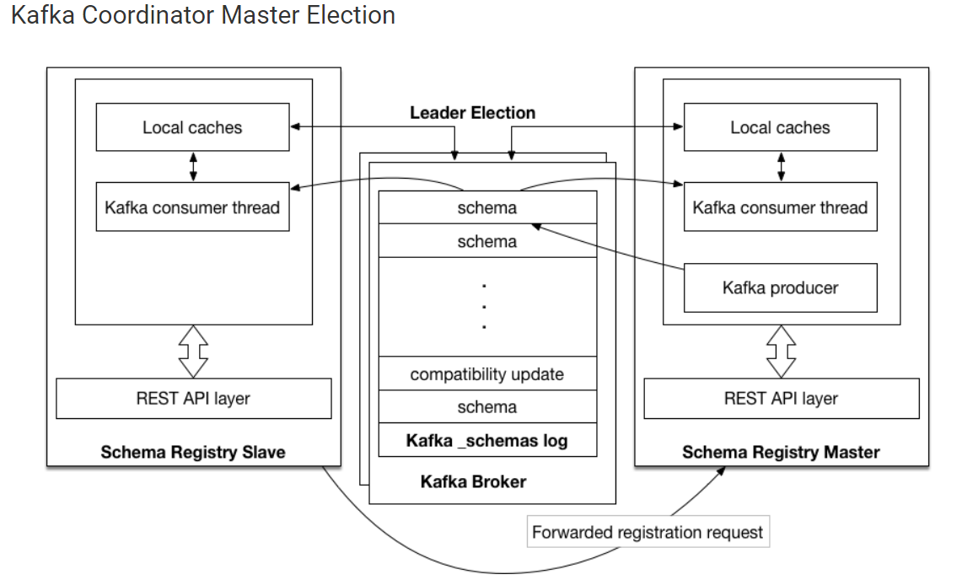
Single Master Architecture for schema registry
3. Kafka Confluent - schema registry support
Schema Registry is designed to work as a distributed service using single master architecture. In this configuration, at most one Schema Registry instance is master at any given moment (ignoring pathological ‘zombie masters’). Only the master is capable of publishing writes to the underlying Kafka log, but all nodes are capable of directly serving read requests. Slave nodes serve registration requests indirectly by simply forwarding them to the current master, and returning the response supplied by the master. Prior to Schema Registry version 4.0, master election was always coordinated through ZooKeeper. Master election can now optionally happen via Kafka group protocol as well.
Kafka based schema registry

Slide 8
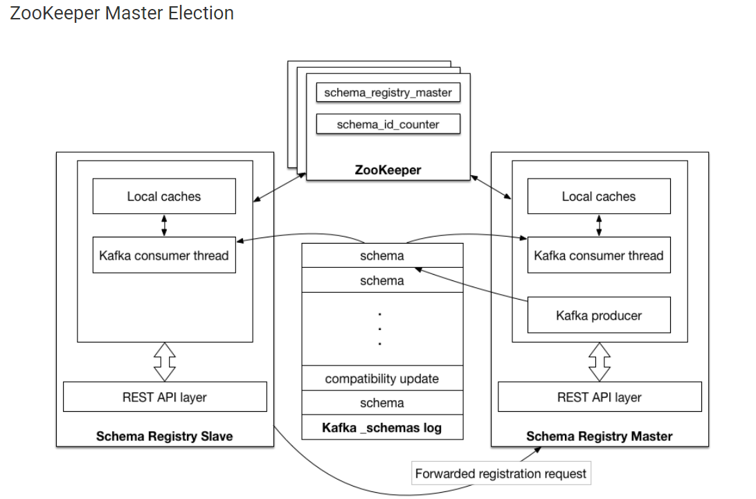
Zookeeper based schema registry

Slide 9
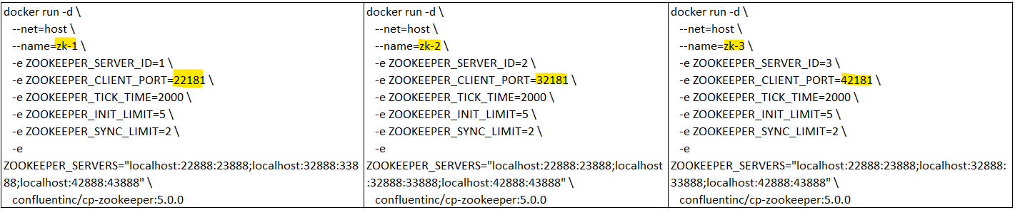
Confluent Installation Steps :
Run three instances of Zookeeper Ensemble & check logs (docker logs zk-1) :
2. Check the Docker mode - docker run --net=host --rm confluentinc/cp-zookeeper:5.0.0 bash -c "echo stat | nc localhost $port | grep Mode“
Output(1 leader and 2 follower)– Mode: follower, Mode: leader, Mode: follower
3. Now that ZooKeeper is up and running, we can fire up a three node Kafka cluster.
4. Check the logs to see the broker has booted up successfully
docker logs kafka-1, docker logs kafka-2, docker logs kafka-3
5. You should see start see bootup messages.
INFO [KafkaServer id=1003] started (kafka.server.KafkaServer)

Slide 10
6. You should see the messages like the following on the broker acting as controller.
[2022-05-14 18:52:44,380] TRACE [Controller id=1001 epoch=1] Received response {error_code=0} for request UPDATE_METADATA with correlation id 1 sent to broker localhost:39092 (id: 1002 rack: null) (state.change.logger)
[2022-05-14 18:52:44,514] TRACE [Controller id=1001 epoch=1] Received response {error_code=0} for request UPDATE_METADATA with correlation id 0 sent to broker localhost:49092 (id: 1003 rack: null) (state.change.logger)
7. Verify the running containers.
gurpreet_singh_maken@LAPTOP-JGPS4HF8:/mnt/d/kafka$ sudo docker ps
CONTAINER ID IMAGE COMMAND CREATED STATUS PORTS NAMES
f786ed8063af confluentinc/cp-kafka:5.0.0 "/etc/confluent/dock…" 38 hours ago Up 38 hours kafka-3
750fa68c0a86 confluentinc/cp-kafka:5.0.0 "/etc/confluent/dock…" 38 hours ago Up 38 hours kafka-2
8079b44d9492 confluentinc/cp-kafka:5.0.0 "/etc/confluent/dock…" 38 hours ago Up 38 hours kafka-1
75408d783c94 confluentinc/cp-zookeeper:5.0.0 "/etc/confluent/dock…" 40 hours ago Up 40 hours zk-3
f01eb425aea0 confluentinc/cp-zookeeper:5.0.0 "/etc/confluent/dock…" 40 hours ago Up 40 hours zk-2
8cdf2b2ba854 confluentinc/cp-zookeeper:5.0.0 "/etc/confluent/dock…" 40 hours ago Up 40 hours zk-1
8. Test that the broker is working as expected.
gurpreet_singh_maken@LAPTOP-JGPS4HF8:/mnt/d/kafka$ sudo docker run --net=host --rm confluentinc/cp-kafka:5.0.0 kafka-topics --create --topic position-topic --partitions 3 --replication-factor 3 --if-not-
exists --zookeeper localhost:32181
Created topic "position-topic".
9. Verify the created topic.
gurpreet_singh_maken@LAPTOP-JGPS4HF8:/mnt/d/kafka$ sudo docker run \
> --net=host \
> --rm \
> confluentinc/cp-kafka:5.0.0 \
> kafka-topics --describe --topic position-topic --zookeeper localhost:32181
Topic:position-topic PartitionCount:3 ReplicationFactor:3 Configs:
Topic: position-topic Partition: 0 Leader: 1002 Replicas: 1002,1001,1003 Isr: 1002,1001,1003
Topic: position-topic Partition: 1 Leader: 1003 Replicas: 1003,1002,1001 Isr: 1003,1002,1001
Topic: position-topic Partition: 2 Leader: 1001 Replicas: 1001,1003,1002 Isr: 1001,1003,1002

Slide 11
